Slide 1
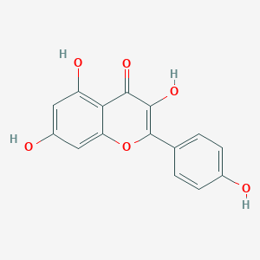
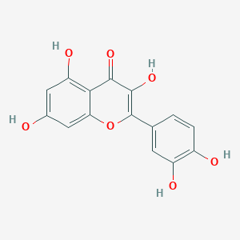
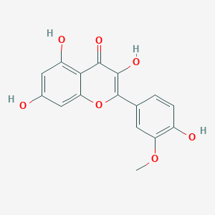
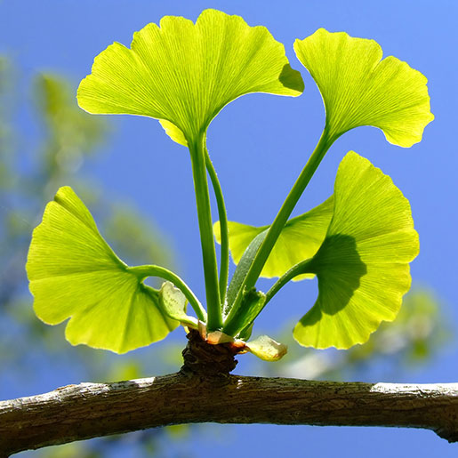

LC-MS Analysis of Flavonoids in Ginkgo Supplements
Azfar Dhanani and Sharon Guan
Georgia Gwinnett College, Lawrenceville, GA 30043
Background
Chemical Structures
Analysis
Ginkgo biloba leaf extract is one of the best-selling herbal supplements in America and is widely used for the treatment of diseases such as cardiovascular disease, Alzheimer’s disease, concentration difficulties, memory loss, and depression. Apparently, the effectiveness of these substances depends largely on the contents of the Ginkgo leaf extracts. However, the standardization of Ginkgo. biloba leaf extract is problematic due to insufficiently revealed relation between bioactive compounds and their therapeutic response. There are few reports on determination and comparison of bioactive compounds from Ginkgo leaf extract. The objectives of the proposed research is to study the content of bioactive compounds in commercial products to ensure that customers are aware of their dosage levels using the most advanced sample preparation and state-of-art instrumentation. Three major flavonoids from Ginkgo extract (Quercetin, Kaempferol, and Isorhamnetinin) are selected in the current project to evaluate and compare the actual bioactive compounds with the content as claimed on the label of the commercial product.
Kaempferol
Molecular Formula: C15H10O6
Molecular weight: 286.23
Quercetin
Molecular Formula: C15H10O7
Molecular weight: 302.24
Isorhamnetin
Molecular Formula: C16H12O7
Molecular weight: 316.26
Detection and Quantitation
1
Figure 4: Peak area degradation of quercetin, kaempferol, and isorhamnetin
1
Figure 1: Ginkgo biloba leaves and different commercial products of herbal supplements
Flavonoids
Polyphenolic molecules containing 15 carbon atoms and are soluble in water.
Can be found in fruits, vegetables, and grains.
Have properties which are beneficial to health including anti-oxidative, anti-inflammatory, and anti-carcinogenic
Help regulate cellular activity and fight off free radicals that cause oxidative stress on your body
Figure 2: Typical total ion chromatogram (TIC) and extracted ion chromatograms (EICs) for 500 ng/uL of standard mixture: Black trace, TIC; Red trace, EIC of Kaempferol; Green trace, EIC of Quercetin; Blue trace: EIC of Isorhamnetin
Experimental
Figure 5: Percentage of quercetin, kaempferol, and isorhamnetin after the 1st injection
HPLC system: Agilent 1100 series HPLC system (Agilent Technologies, Santa Clara, CA), consisted of a G1379A online degasser, a G1311A quaternary pump, a G1313A autosampler and a G1316A column compartment.
HPLC column: Gemini-NX C18 column (150 mm × 2.0 mm i.d., 3 µm particle size, maintained at 30 °C) from Phenomenex (Torrance, CA).
Mobile phase: 0.2% (v/v) formic acid in 10% aqueous acetonitrile (A) and 0.2% (v/v) formic acid in 100% acetonitrile (B). The gradient program was as follows: 0-4 min, 30-100% B; 4-8 min, 100% B; 8-8.1 min, 100-30% B; 8.1-20 min, 30% B at a flow rate of 0.20 mL/min. The injection volume was 5.0 µL.
Detection was done using an LTQ XL mass spectrometer from Thermo Fisher Scientific (Waltham, MA) coupled with an electrospray ionization (ESI) interface. Nitrogen was used as the sheath and auxiliary gases of the ion source, while helium was used as the damping gas for the ion trap. The three flavonoids were ionized under the negative ESI mode. In this study, the ion source parameters were optimized as follows: ESI voltage, -4000 V; sheath gas, 30; auxiliary gas, 10; capillary temperature, 275 °C; capillary voltage, -47.5 V; tube lens voltage, -115 V. The samples were analyzed with a selected ion monitoring (SIM) method by scanning the dominant [M-H]- mass ranges for each analyte: Quercetin, 300-302 m/z; Kaempferol, 284-286 m/z and Isorhamnetin, 314-316 m/z. LC-MS data were acquired and processed using Xcalibur 4.3 software from Thermo Fisher Scientific.
Results and Discussion
LC-MS is suitable for analysis of flavonoids in Ginkgo biloba extract since the three flavonoids have very similar chemical structures and it is not practical to separate them using HPLC-UV.
The mass spectrometer provided high sensitivity that enable us to determine all three Ginkgo biloba flavonoids at ppb levels which is much lower than the average concentration of flavonoids in Ginkgo biloba.
The current LC-MS provides good linearity for analysis of Ginkgo biloba flavonoids (10-2000 ppb).
It was found that all three flavonoids experienced degradation at room temperature when 30% acetonitrile was used as solvent. It is important to inject to LC-MS within one hour after sample extraction.
References
Z. Lucia, S. Štefan, S. Stanislav, J. Lukáš. Determination of the antioxidant activity of Ginkgo biloba leaves extract. Journal of Food and Nutrition Research. 2007, 46(1),15-19.
S. Kaur, N. Sharma, B. Nehru. Anti-inflammatory effects of Ginkgo biloba extract against trimethyltin-induced hippocampal neuronal injury. Inflammopharmacology. 2018, 26(1), 87-104.
4. Gail B. Mahady. Ginkgo Biloba for the Prevention and Treatmentof Cardiovascular Disease: A Review of the Literature. J Cardiovasc Nurs, 2002, 16(4), 21-32.
Figure 3: Linear calibration of Kaempferol, Quercetin, and Isorhamnetin analysis using LC-MS

